Slide 1
Intelligent Agents
Chapter 2

Slide 2
Outline
Agents and environments
Rationality
PEAS (Performance measure, Environment, Actuators, Sensors)
Environment types
Agent types

Slide 3
Agents
An agent is anything that can be viewed as perceiving its environment through sensors and acting upon that environment through actuators
Human agent: eyes, ears, and other organs for sensors; hands, legs, mouth, and other body parts for actuators
Robotic agent: cameras and infrared range finders for sensors; various arms/legs/motors for actuators

Slide 4

Agents and environments
The agent function maps from percept histories to actions :
  [f: P* → A] (抽象的数学描述)
The agent program runs on the physical architecture to produce f
  agent = architecture + program（具体实现）

Slide 5

Vacuum-cleaner world
Percepts: location and contents, e.g., [A,Dirty]
Actions: Left, Right, Suck, NoOp

Slide 6
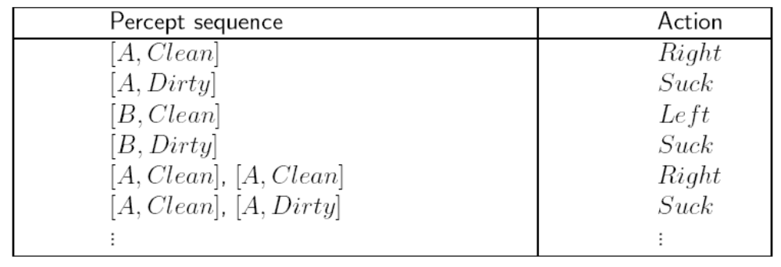
A vacuum-cleaner agent
?

Slide 7
Rational agents
An agent should strive to "do the right thing", based on what it can perceive and the actions it can perform. The right action is the one that will cause the agent to be most successful
Performance measure: An objective criterion for success of an agent's behavior
E.g., performance measure of a vacuum-cleaner agent could be amount of dirt cleaned up, amount of time taken, amount of electricity consumed, amount of noise generated, etc.

Slide 8
Rational agents
Rational Agent: For each possible percept sequence, a rational agent should select an action that is expected to maximize its performance measure, given the evidence provided by the percept sequence and whatever built-in knowledge the agent has.

Slide 9
Rational agents
Rationality is optimization under constraints. It’s distinct from omniscience (all-knowing with infinite knowledge)
Agents can perform actions to gather useful information which could result in better performance (information gathering, exploration. 场景：过马路)
An agent is autonomous if its behavior is determined by its own experience (with ability to learn and adapt)

Slide 10
PEAS
PEAS: Performance measure, Environment, Actuators, Sensors (task environment)
Must first specify the setting of these four aspects before the design of an intelligent agent
Consider, e.g., the task of designing an automated taxi driver:
  Performance measure？
  Environment ？
  Actuators ？
  Sensors?

Slide 11
PEAS – automated taxi driver
Agent:an automated taxi driver
Performance measure: Safe, fast, legal, comfortable trip, maximize profits
Environment: Roads, other traffic, pedestrians, customers，weather
Actuators: Steering wheel, accelerator, brake, signal, horn, display
Sensors: Cameras, sonar, speedometer, GPS, odometer, engine sensors, gauges, keyboard

Slide 12
PEAS - Medical diagnosis system
Agent: Medical diagnosis system
Performance measure: Healthy patient, minimize costs and lawsuits
Environment: Patient, hospital, staff
Actuators: Screen display (questions, tests, diagnoses, treatments, referrals)
Sensors: Keyboard, mouse (entry of symptoms, findings, patient's answers)

Slide 13
PEAS - Part-picking robot
Agent: Part-picking robot
Performance measure: Percentage of parts in correct bins
Environment: Conveyor belt with parts, bins
Actuators: Jointed arm and hand
Sensors: Camera, joint angle sensors

Slide 14
PEAS - Interactive English tutor
Agent: Interactive English tutor
Performance measure: Maximize student's score on test
Environment: Set of students
Actuators: Screen display (exercises, suggestions, corrections)
Sensors: Keyboard, mouse

Slide 15
Environment types
Fully observable (vs. partially observable): An agent's sensors give it access to the complete state of the environment at each point in time.
Deterministic (vs. stochastic): The next state of the environment is completely determined by the current state and the action executed by the agent. (If the environment is deterministic except for the actions of other agents, then the environment is strategic)
Episodic (vs. sequential): The agent's experience is divided into atomic "episodes" (each episode consists of the agent perceiving and then performing a single action), and the choice of action in each episode depends only on the episode itself.

Slide 16
Environment types
Static (vs. dynamic): The environment is unchanged while an agent is deliberating. (The environment is semidynamic if the environment itself does not change with the passage of time but the agent's performance score does)
Discrete (vs. continuous): A limited number of distinct, clearly defined percepts and actions.
Single agent (vs. multiagent): An agent operating by itself in an environment.

Slide 17
Environment types
Chess with Chess without Taxi driving
a clock a clock
Fully observable Yes Yes No
Deterministic Strategic Strategic No
Episodic No No No
Static Semi Yes No
Discrete Yes Yes No
Single agent No No No
打牌的环境？
The environment type largely determines the agent design
The real world is (of course) partially observable, stochastic, sequential, dynamic, continuous, multi-agent

Slide 18
Agent functions and programs
An agent is completely specified by the agent function mapping percept sequences to actions
Our aim: find a way to implement the rational agent function concisely
至于把函数变成程序，不做具体讨论

Slide 19
Table-lookup agent
Function TABLE_DRIVEN_AGENT(percept) returns an action
  append precept to percepts;
  action = LOOKUP (percepts, table);
  return action
Drawbacks:
  Huge table
  Take a long time to build the table
  No autonomy
  Even with learning, need a long time to learn the table entries

Slide 20

例子：求平方根
表 （我们学对数的时候还用对数表）
牛顿法(find b's square root x)

Slide 21
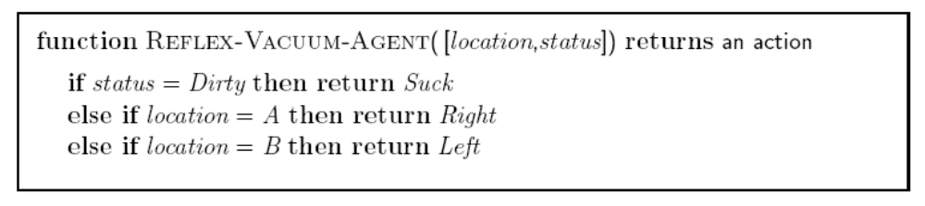
Agent program for a vacuum-cleaner agent

Slide 22
Agent types
Four basic types in order of increasing generality:
Simple reflex agents
Model-based reflex agents
Goal-based agents
Utility-based agents
All these can be turned into learning agents

Slide 23

Simple reflex agents

Slide 24
Simple reflex agents
Function SIMPLE_REFLEX_AGENT(percept) returns an action
  state = INTERPRET-INPUT(percept);
  rule = RULE-MATCH(state, rules);
  action = RULE-ACTION[rule];
  return action
Acts on the current percept / fully observable environment

Slide 25

Model-based reflex agents
模型=对世界的状态描述+世界如何演变
我的行动的效果可影响世界（=环境+我）

Slide 26
Model-based reflex agents
Function REFLEX_AGENT_WITH_STATE(percept) returns an action
  state = UPDATE-STATE(state,action,percept);
  rule = RULE-MATCH(state, rules);
  action = RULE-ACTION[rule];
  return action
  最简单的模型是有限状态机。

Slide 27

Goal-based agents

Slide 28
We need search and planning to achieve the goal
搜索是下一章的主题

Slide 29

Utility-based agents

Slide 30

Learning agents

Slide 31
具有学习能力的agent
什么是（机器）学习？
  [An agent] is said to learn from experience E with respect to some class of tasks T and performance measure P, if its performance at tasks in T, as measured by P, improves with E. (Mitchell, 1997, p. 2)
要素
  Experience(data/corpus),
  Critic，
  Target function (task, performance measure),
  Algorithms (knowledge)

Slide 32
具有学习能力的agent
数据是学习的核心要素
  学习不是演绎推理，是归纳推理。处理新数据是关键
Critic确定了学习的分类
  有监督学习
  无监督学习
  半监督学习,弱监督学习,强化学习
目标函数决定了学习的难易程度
  一般，目标函数是已知的，学习算法只是调整目标函数的参数

Slide 33
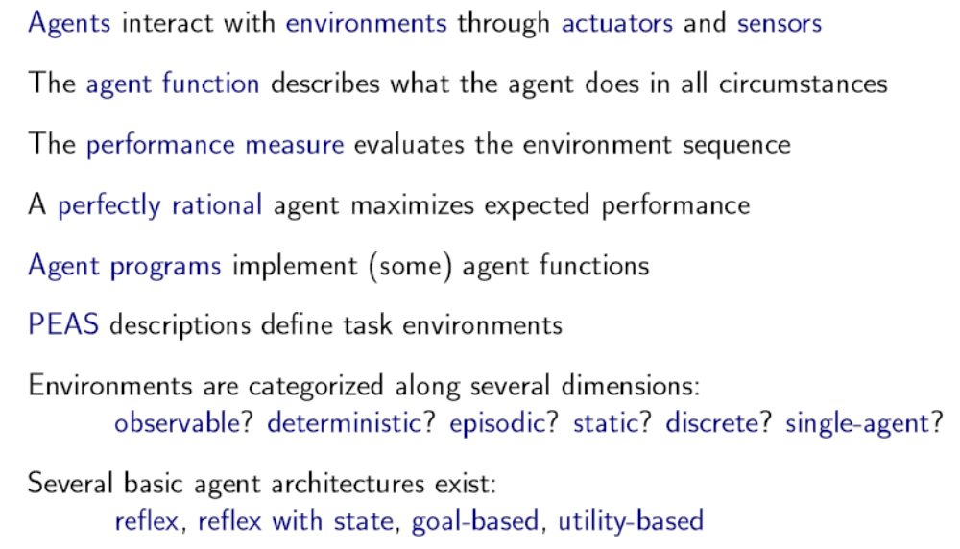
小结

Slide 34
作业
2.5 For each of the following agents, develop a PEAS description of the task environment:
  a. Robot soccer player;
  b. Internet book-shopping agent;
  c. Autonomous Mars rover;
  d. Mathematician's theorem-proving assistant.

